Slide 1
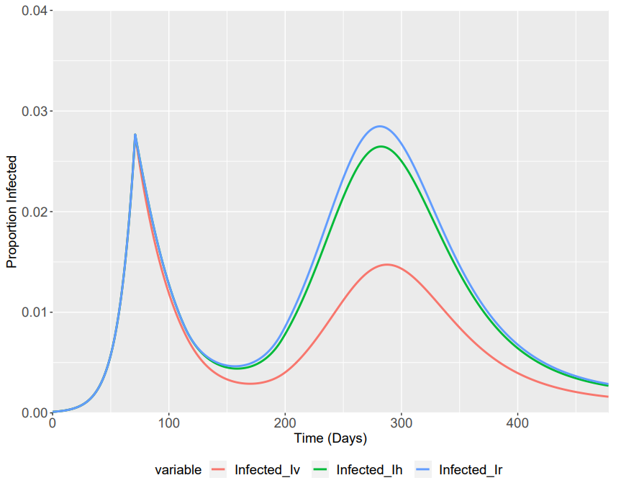
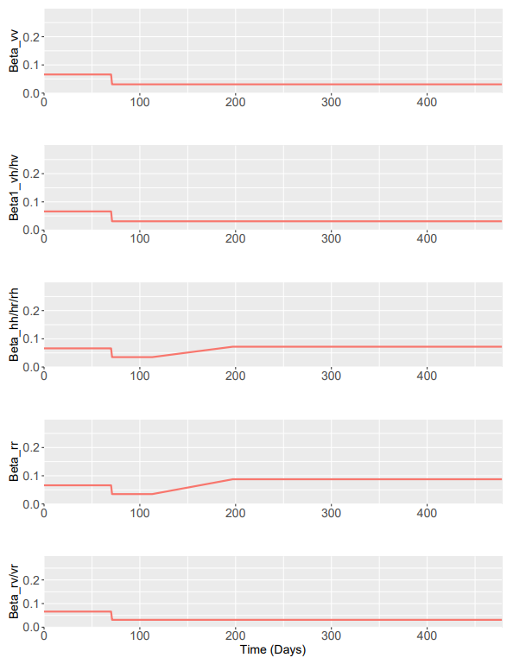
Assuming R0 Limits in Phase 4 of:
Central Scenario
Betas | Lower | Central | Upper
β1 | 0.8 (No Enhanced Shielding – Stays the Same) | 0.8 | 0.8
β2 | 0.9 | 1.575 | 2.8
β3 | 1.7 | 2.25 | 2.8

Slide 2
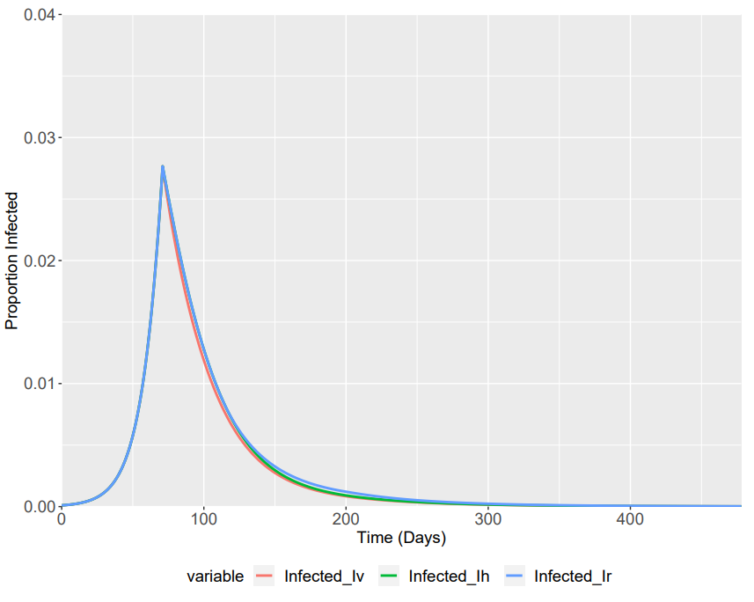
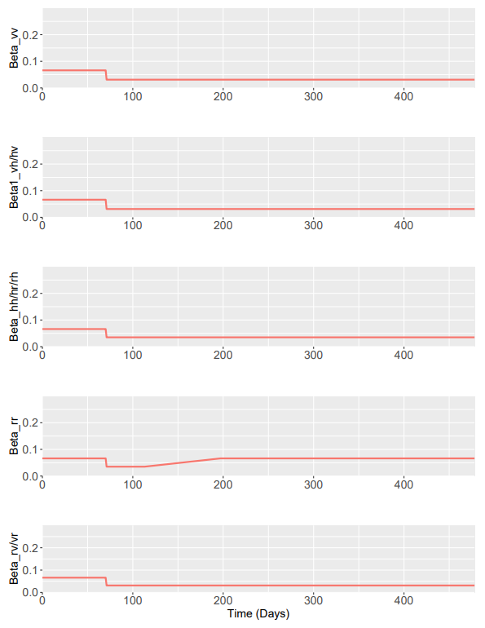
Assuming R0 Limits in Phase 4 of:
Lower Beta Scenario
Betas | Lower | Central | Upper
β1 | 0.8 (No Enhanced Shielding – Stays the Same) | 0.8 | 0.8
β2 | 0.9 | 1.575 | 2.8
β3 | 1.7 | 2.25 | 2.8

Slide 3
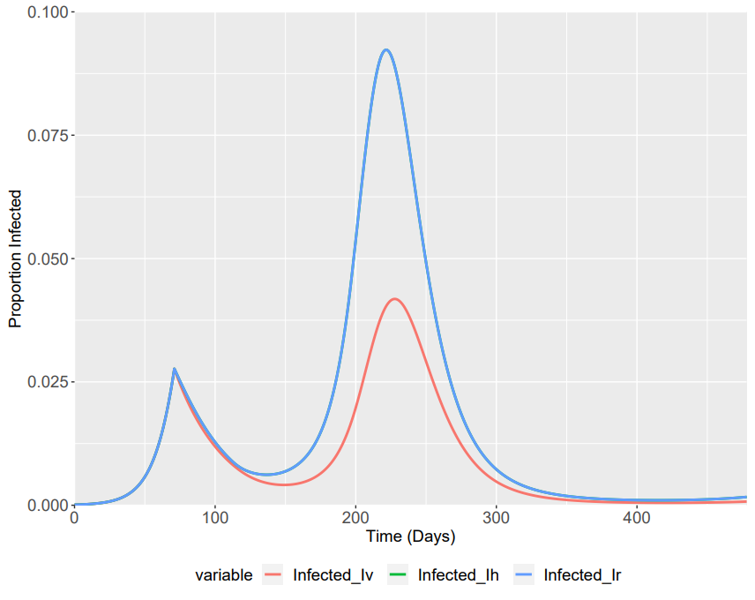
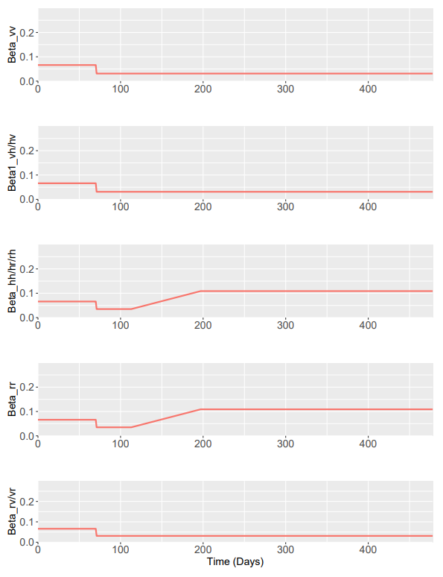
Assuming R0 Limits in Phase 4 of:
Maximum Beta Scenario
Betas | Lower | Central | Upper
β1 | 0.8 (No Enhanced Shielding – Stays the Same) | 0.8 | 0.8
β2 | 0.9 | 1.575 | 2.8
β3 | 1.7 | 2.25 | 2.8

